Slide 1
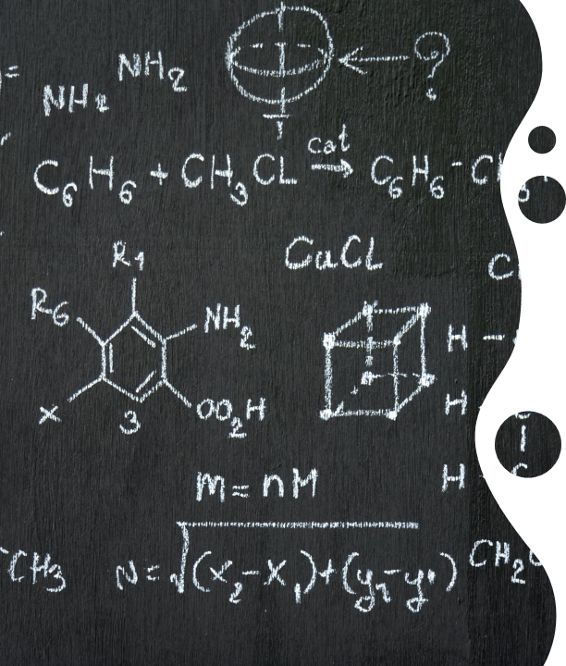
MatheMedica Python Library Project
Dr.Heba Elhadidi
Maryam Mohamed Tharwat

Slide 2
Introduction
The MatheMedica Python library is an integrated toolkit designed to provide solutions for both mathematical and medical computations.
This project reflects a multifaceted approach to problem-solving by addressing common mathematical and healthcare needs within a single software solution.
The library comprises a comprehensive collection of functions categorized into Mathematical Functions and Medical Functions, ensuring versatility and usability across diverse applications.

Slide 3
Project Objective
The primary objective of this project was to develop a reusable Python library that simplifies complex mathematical and medical calculations.
It aims to assist students, researchers, and healthcare professionals by automating repetitive tasks, ensuring accurate results, and promoting efficient data processing.

Slide 4

Features and Functionalities

Slide 5
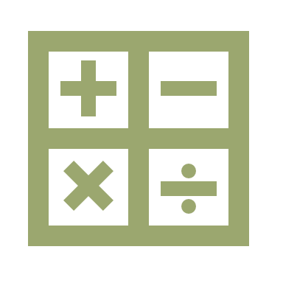
Mathematical Functions
Pascal’s Triangle (regular and reversed)
Matrix operations (addition, subtraction, multiplication)
Prime number verification
Area and volume calculations for various geometric figures
Armstrong and perfect number checks

Slide 6
Mathematical Functions
Palindrome detection
Permutations and combinations
Divisor and GCD calculations
Fibonacci series (both forward and reversed)
Mean, median, and mode computations

Slide 7
Medical Functions
BMI and body fat percentage calculations
Glucose, blood pressure, and oxygen level tracking
Cholesterol and protein level analysis
Sleep quality and hydration evaluation

Slide 8
Medical Functions
Iron and fiber intake recommendations
Growth and kidney health checks
Basal Metabolic Rate (BMR) and carbohydrate requirements
Menstruation advice and muscle strength evaluation

Slide 9
Implementation Details
The project was implemented in Python, utilizing standard libraries and adhering to modular design principles.
Each function is independent and follows a clear, logical structure to enhance readability and maintainability.

Slide 10
Use Cases
Educational Purposes
The mathematical tools can aid students in solving complex problems, learning programming, and understanding algorithms.
Healthcare Applications
The medical functions provide an accessible resource for tracking health metrics and offering preliminary health advice.

Slide 11
Example Functionality
BMI Calculation: Determines the BMI category based on weight and height, offering actionable insights for healthcare users.
Matrix Multiplication: Facilitates mathematical computations for users in data science and academic research.

Slide 12
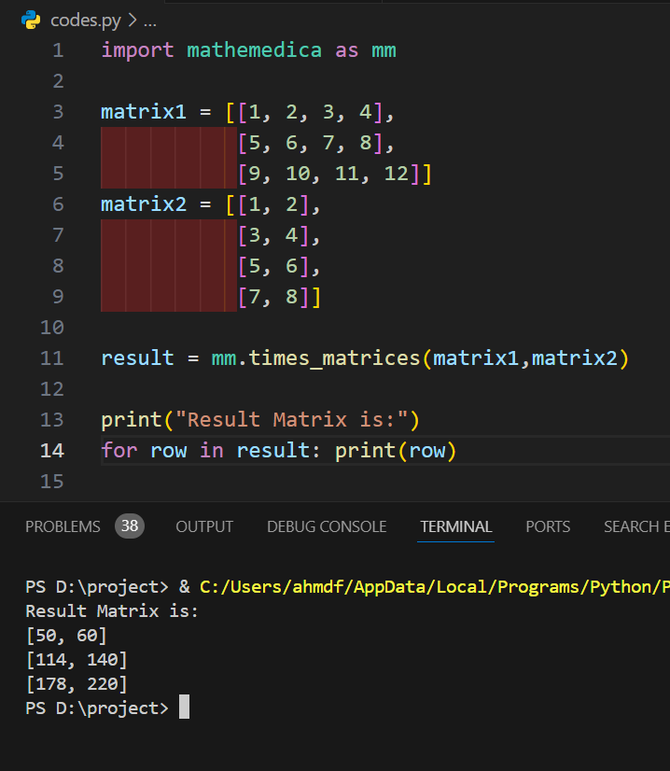
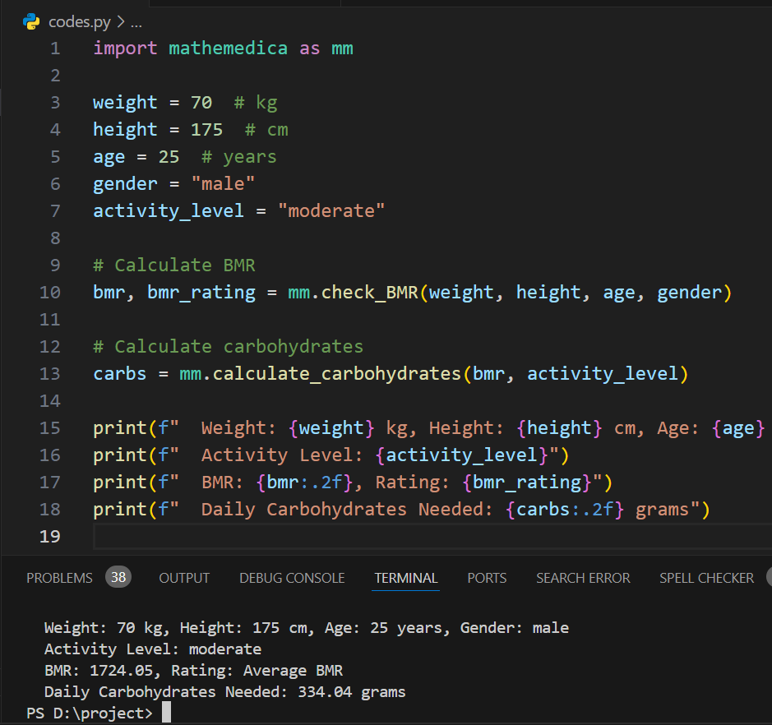
Example Code

Slide 13
End Points
The MatheMedica library is a robust and versatile tool, bridging the gap between mathematical computations and medical analysis.
It represents a significant step in integrating diverse functionalities within a single software package, offering utility and efficiency to its users.

Slide 14
Thank You

